Slide 1
Lecture 2.1 Introduction to Deep learning

Slide 2
Motivation
The performance of traditional machine learning models (such as linear and logistic regression, Naïve Bayes, Support Vector Machines, decision trees and their ensemble) depends heavily on the representation of the data they are given.
For instance, suppose the logistic regression is used to recommend cesarean delivery. The AI system does not examine the patient directly. Instead, the doctor tells the system several pieces of relevant information, such as the presence or absence of a uterine scar. Each piece of information included in the representation of a patient is known as a feature.
Logistic regression learns how each of these features is related to the various outcomes.
However, if logistic regression is given an MRI scan of the patient, rather than the doctor’s hand-crafted features, it would not be able to make any useful prediction because individual pixels in the MRI scan have negligible correlation with any complications that may occur during delivery.
Many AI tasks can be solved by designing the right set of features. In traditional machine learning, the burden of designing a right set of features falls to the programmer. Designing right features is more of an art than science.

Slide 3
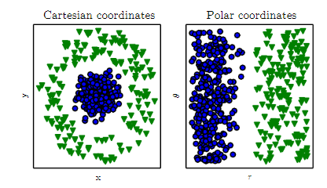
Data Representation and machine learning models
It is not surprising that the choice of data representation ( i.e. features) has an enormous affect of the performance of a machine learning algorithm.
Suppose we want to train a linear model that can separate the blue data points from the green data points on the picture on the left.
If we represent data in the original Cartesian coordinates it would be impossible to find a line that separates the green examples from the blue examples.
However, if we cleverly represent the data in polar coordinate ( where each data point is represented by its radial distance (x-axis) and angle from the origin (y-axis), then the data points can be easily separated with a line.

Slide 4
Representation Learning
For many tasks it is difficult to know what features should be extracted.
For instance, suppose we want to create a ML model to detect cars in a picture. What should we give as features to this model?
We know that cars have wheels but so we might want to use presence of wheels as a feature but it is difficult to quantify wheels in terms of image pixel values.
A wheel has a simple geometric shape but its image may be complicated by shadows falling on the wheel, the sun glaring off the metal parts or an object in the foreground obscuring the part of the wheel and so on.
One solution is to let the machine learning model to discover not only a mapping between feature and the output but also the features itself from the raw data. This is known as representational learning.
For instance extracting features from raw image pixels that can be used to detect cars in an image.
Representation learning has several advantage over hand-crafted features:
It often leads into a much better performance than giving hand-crafted features to the ML model
It is often expensive, time consuming and laborious ( sometimes impossible) for humans to handcraft right set of features for a complex task
Representation learning allow ML models to rapidly adapt to new tasks with minima human intervention.

Slide 5
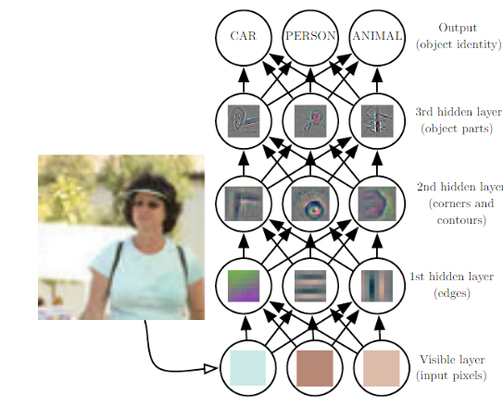
Deep learning: Successive layers of representation
Deep Learning is a subfield of machine learning that effectively tries to address the problem of representation learning by introducing representations that are expressed in terms of successive layers of other, simpler representations.
The word deep in deep learning isn’t a reference to any kind of deeper understanding achieved by the approach; rather, it stands for this idea of successive layers of representations. The number of layers of simpler representations in deep learning is referred to as depth of a deep learning model.
This figure shows how a deep learning system can represent the concept of an image of a person by combining layers of simpler concepts such as corners and contours which are defined in terms of edges
The first layer at the bottom is called the input/visible layer because it contains the variables that we are able to observe ( such as raw pixel values of an image)
Then a series of hidden layers, extract a set of abstract features from the input layer. They are called hidden because their values are not given in the data but are extracted by the model
The final layer ( is called the output layer) which is the final output of the model based on the features extracted by the hidden layers. The output of the model in this figure is one of the several classes on objects that present in the image (such as person, car, animal, etc.)

Slide 6
What deep learning has achieved so far?
Deep learning thrives for perceptual problems involving skills that seem natural and intuitive to humans but have long been elusive for machines, such as hearing and vision.
These type of problems are typically very difficult to formalize and are very high dimensional and this is where deep learning shines with its ability to automatically extracts features through several layers of simple representation.
Here are some examples of historically difficult problems for machine learning where deep learning has achieved a revolutionary break through:
Near human level image classification Near human level speech recognition Near human level hand-writing transcription Improved machine translation Improved text to speech conversion Digital assistance such as Alexa and Google Now Near human level autonomous driving | Improved ad targeting, as used by Google, Baidu, and Bing Improved search results on the web Ability to answer natural-language questions Superhuman Go playing

Slide 7
Deep Learning Short-term Hype
Although deep learning has led to remarkable achievements in recent years, expectations for what the field will be able to achieve in the next decade tend to run much higher than what will likely be possible
Although applications such as self-driving cars are already within reach, many more application such as a human-like dialog system, human-level natural language understanding and translation to arbitrary language are likely to remain elusive for a while.
The risk of high expectation for a short term may result in another AI winter ( a cycle of intense optimism, followed by disappointment and skeptism with funding dried up as a result ( this happened twice to AI around 1960’s with symbolic AI and around 1980s with the advent of expert systems)
We may be currently witnessing the third cycle of AI hype and disappointment and we are still in the phase of intense optimism. So it is best to moderate our short term expectation and make sure that people less familiar with the technical side of the field have a clear understanding what AI can or cannot achieve

Slide 8
Deep Learning Long-term promise
The long term picture for deep learning, however, is looking bright. We are only getting started in applying deep learning to many important transformative problems from medical diagnosis, protein engineering, targeted therapy to digital assistance
AI research as been moving at an incredible speed in the last decade with the advent of deep learning. Most of these research findings haven’t yet been applied to the full range of problems they can solve across industries. AI has yet to transition to being central ( rather than accessory ) to our day-to-day life (much like the Internet today)
More importantly AI will help humanity as a whole move forward, by assisting human scientists in new breakthrough discoveries across all scientific fields, from genomics to mathematics.
We might end up going through another AI winter but we will get there eventually.
Don’t believe in short term hype but do believe in long term vision.

Slide 9
Before Deep Learning: A brief timeline in Machine Learning history
Although deep learning is getting a lot of public attention and industry investment; it is safe to say that most of the machine learning algorithms used in industry today are not deep learning algorithms.
Because deep learning is not always a right tool for a machine learning problem.
Sometimes there isn’t enough data for deep learning to be applicable
Sometimes the problem is better solved by lower capacity, more simple machine learning algorithms
If your first exposure to machine learning is through deep learning, then you deep learning might start to look like a hammer and every machine learning problem might start look like a nail. The only way t not fall into this trap is to be familiar with other ML algorithm and know what type of problems are better solved by deep learning as opposed to more traditional ML algorithms.

Slide 10
Early neural networks
Deep learning dates back to 1940 and it only appears to be “new” because it was relatively unpopular for several years before its current popularity.
The field has gone through many different names (such as cybernetics, connectionism, and artificial neural networks) and rebranded multiple times throughout its history reflecting the influence of different researchers and perspectives.
Although the core ideas of neural networks were investigated in toy forms as early as the 1940s, the approach took decades to get started.
For a long time, the missing piece was an efficient way to train large neural networks.
This change in 1980s when multiple people independently rediscovered the Backpropagation algorithm— a way to train chains of parametric operations using gradient-descent optimization. The backpropagation algorithm remains the principal learning algorithm in various forms of deep learning algorithms today and will be discussed in detail in this class.
The first successful practical application of neural nets came in 1989 from Bell Labs, when Yann LeCun combined the earlier ideas of convolutional neural networks (will be discussed later) and backpropagation, and applied them to the problem of classifying handwritten digits.
The resulting network, dubbed LeNet, was used by the United States Postal Service in the 1990s to automate the reading of ZIP codes on mail envelopes

Slide 11
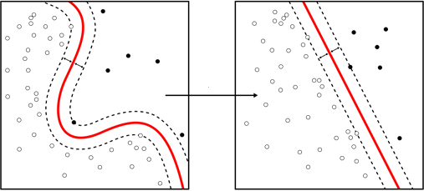
Kernel Models outshined neural networks
Artificial Neural Networks started to gain some respect among researchers in early 1990s until a new approach to machine learning, known as kernel methods rose to fame and sent neural network back to oblivion.
Kernel methods are a group of classification algorithms, the best known of which is the support vector machine (SVM)
SVM aims at solving a classification algorithm by finding a good decision boundary that can separate the data.
SVM finds the decision boundary by transforming non-linearly separable data to a higher dimension where data becomes linearly separable( details on SVM is out of scope of this class but is covered in a machine learning course)
When it comes to perceptual problems (such as the ones listed in slide 6),the kernel methods suffer from the same drawback as the other traditional ML algorithm and that is, they require extracting useful features manually which is difficult and brittle.
Source Wikipedia

Slide 12
Decision Trees Random Forest and Gradient Boosted Machines Became Popular
Decision trees are flowchart-like structures that let you classify input data points or predict output values given inputs
Decisions trees learned from data began to receive significant research interest in the 2000s, and by 2010 they were often preferred to kernel methods.
In particular, Random Forest and gradient boosted machines algorithms introduced a robust, practical take on decision-tree learning that involves building a number of specialized decision trees and then ensembling their outputs. (details are out of scope of this class but are covered in machine learning class) .
These two algorithms are among the best and most popular algorithms today to deal with non-perceptual, structured data.

Slide 13
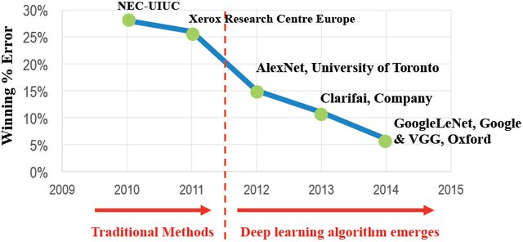
Neural Networks Come back with deep learning
Although neural networks were mostly abandoned by scientific community, a number of people working on neural network ( in particular, the groups of Geoffrey Hinton at the University of Toronto, Yoshua Bengio at the University of Montreal, Yann LeCun at New York University, and IDSIA in Switzerland) started to make important breakthroughs.
The breakthrough moment came in 2012, where Hinton’s group won the ImageNet challenge.
ImageNet was a notoriously difficult challenge at the time involving classifying high resolution color images into 1000 classes after training on 1.4 million images.
A team led by Alex Krizhevsky (Hinton’s student) was able to achieve 83.6% using a convolutional neural network model (known as AlexNet) ( The best classical approaches to computer vision by then had only achieved 74% accuracy)
Since 2012 convolutional neural networks ( will be covered in a later module) has become the go-to algorithm for all computer vision tasks.
At the same time deep learning has also found applications in many other types of perceptual problems such as natural language processing and speech recognition.

Slide 14
What Makes deep learning different
The primary reason deep learning took off so quickly was that it offered better performance on many perceptual problems where it is very hard to hand-craft good set of features for traditional ML algorithms.
The ability of deep neural network to automatically learn features from complex data through many successive layers of simpler representation is the key feature that contributes to the success of deep learning.
One can get a sense of the current landscape of machine learning algorithms by looking at the winning models in Kaggle ( a popular data science competition website)
Kaggle is currently dominated by decision tree ensembles ( random forest and gradient boosting) for structured data and by deep learning for perceptual problems with more complex unstructured data ( such as images, videos, speech and text).
Recall from lecture that that as we increase the capacity of a model, we will need more data to avoid overfitting. Deep learning models have higher learning capacity due to their many layers of representation which means they have more parameters to learn and need more data to learn those parameters or else they overfit.
Deep learning models work best when there are many features and a lot of data.
Many structured problems encountered in traditional machine learning are not complex enough to benefit from using deep learning or neural networks in general. Most of the time a simple linear regression or a decision tree ensemble outperforms a more complex deep neural network for such problems.

Slide 15
Why deep learning took of just recently?
The key ideas that contributed to the success of modern deep learning for tasks such as computer vision and text understanding has been around for a while.
In a particular, convolutional neural networks used for modern computer vision were already well understood by 1989
Another type of neural network called Long-Short-Term memory (LSTM) used predominantly in modern text processing, has also been around since 1997 and has barely changed since?
So why did deep learning only took off after 2012? Why not before that? There are three main reasons:
Hardware
Data
Algorithms

Slide 16
Hardware for deep learning
Between 1990-2010 off-the-shelf CPUs became much faster. As a result nowadays it is possible to run a small deep learning model on your laptop, whereas this would have never been possible 25 years ago.
Typical deep learning models ( used in computer vision or speech recognition and text processing ) require order of magnitude more than what your laptop can deliver.
Deep learning owes much of its advancement today to the gaming industry.
During 2000s Companies such as Nvidia and AMD have been investing billions of dollars to developing fast, massively parallel chips called graphical processing units (GPU) to power the graphics video games.
The learning algorithm in deep neural networks consist of mostly many matrix multiplication operations which are highly parallelizable and therefore can greatly be speeded up by using GPUS.
In 2007 NVIDIA launched CUDA(https://developer.nvidia.com/about-cuda) a programming interface for its line of GPUS which allowed deep learning community to write CUDA implementations of neural networks.
Large companies train deep learning models on clusters of hundreds of GPUs of the types developed specifically for the needs of deep learning
In 2016 google revealed its Tensor Processing Unit (TPU), a new chip designed from ground up specifically for deep learning and tensorflow (Google’s library for deep learning) and is reportedly 10 times faster and far more efficient than top-of-the-line GPUS.

Slide 17
Data For Deep Learning
Another important factor that made deep learning applicable is the rise of internet which made it feasible to collect and distribute large datasets for machine learning
People are now spending more time on digital devices and their digital activities generates a huge amount of data which can be fed to machine learning algorithms.
As the number of layers in a neural network increases, the capacity of the neural network to learn higher level data representation increases and so does its need for more data to robustly train a vast number of parameters without overfitting.
Neural network are famous to be data hungry, the more data you give to your deep neural network, the better they are likely to perform
Today large companies work with image, video, and text that couldn’t have been collected without the internet.
User-generated image tags on Flickr, for instance, have been a treasure trove of data for computer vision. So are You- Tube videos. And Wikipedia is a key dataset for natural-language processing
The ImageNet dataset with 1.4M images in 1000 categories has been a catalyst for the rise of deep learning

Slide 18
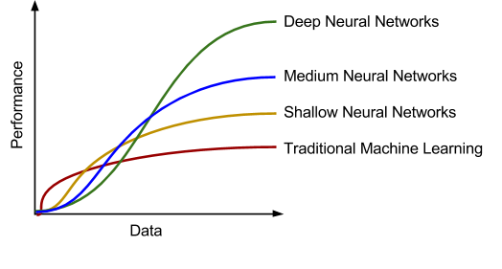
Scaling with data, deep learning vs traditional ML
This figure shows how performance of traditional ML and deep learning models change with the amount of training data.
With small data, neural network’s capacity is too high and they overfit. Traditional ML algorithms typically get a better performance on small data.
As we accumulate more data, usually the performance of the traditional ML algorithms, such as logistic or linear regression increases and quickly reaches a plateau (meaning after a certain point, adding more data does not improve the performance of the model). As if those algorithms didn’t know what to do with all that extra data.
After this point, If you train a small neural network ( small number of hidden layers and small number of parameters) on the same task, you might get a slightly better performance as the size of the data increases.
Finally if you train larger/deeper neural networks (hundreds or thousands of layers) on very large dataset (millions and trillions of examples), you can get the best performance

Slide 19
Improved Algorithms for deep learning
In addition to hardware and data, until the late 2000s we were missing a reliable way to train very deep neural networks.
Neural networks were still fairly shallow with only one or two hidden layers which could not outperform against more refined models such as SVM and random forest.
This changed around 2009-2010 with the advent of several simple improvement to the neural network learning algorithm which made it more robust to train deeper neural networks
We will talk about some of these algorithmic improvements in a later module.
Thanks to the availability of more, faster hardware, and algorithmic improvements, today it is possible to train from scratch, models that are hundreds of layer deep to achieve a remarkable performance on complex tasks that were previously out of reach for machine learning.

Slide 20
End of lecture 2.1

